Slide 1
2³ = 8
2² = 4
2¹ = 2
2⁰ = 1
0
1
2
3
4
5
6
7
8
9
10
11
12
13
14
15
16
[0001]
[0101]
[1011]
[1111]

Slide 2
– 2³ = –8
2² = 4
2¹ = 2
2⁰ = 1
–8
–7
–6
–5
–4
–3
–2
–1
0
1
2
3
4
5
6
7
8
[0001]
[0101]
[1011]
[1111]

Slide 3
– 2³ = –8
2³ = 8
2² = 4
2¹ = 2
2⁰ = 1
–8
–7
–6
–5
–4
–3
–2
–1
0
1
2
3
4
5
6
7
8
9
10
11
12
13
14
15
16
[1011]
+16
[1111]
+16

Slide 4
2^{w}
+2^{w–1}
2^{w–1}
Unsigned
Two’s
complement
0
0
–2^{w–1}

Slide 5
2^{w}
2^{w–1}
+2^{w–1}
Unsigned
Two’s
complement
0
0
–2^{w–1}

Slide 6
– 2³ = –8
– 2² = –4
2² = 4
2¹ = 2
2⁰ = 1
–8
–7
–6
–5
–4
–3
–2
–1
0
1
2
3
4
5
6
7
8
[101]
[1101]
[111]
[1111]

Slide 7
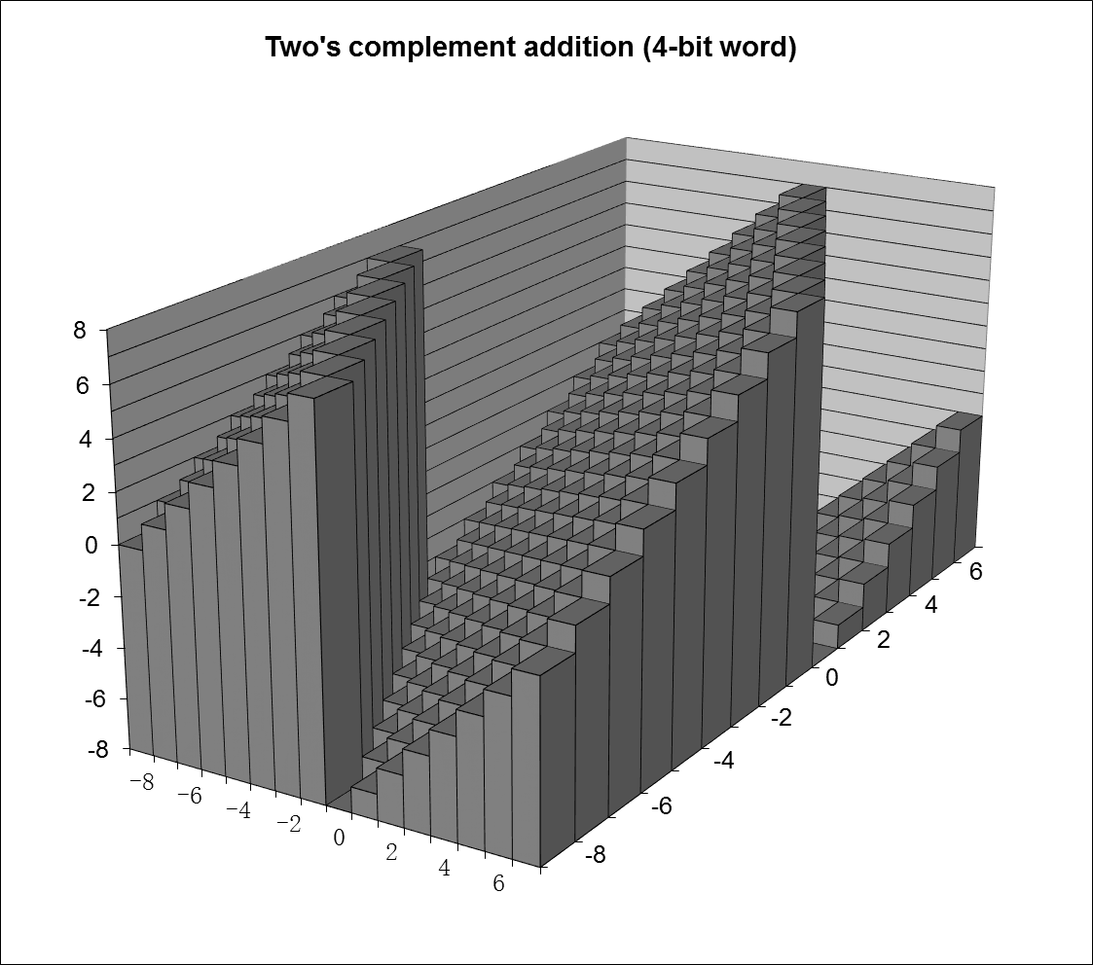

Slide 8
x + y
2^{w+1}
Overflow
x +^{u} y
2^{w}
0
Normal

Slide 9
x + y
+2^{w}
Positive overflow
Case 4
x +^{t} y
+2^{w –1}
+2^{w –1}
Case 3
0
Normal
0
Case 2
–2^{w –1}
–2^{w –1}
Case 1
–2^{w}
Negative overflow

Slide 10
2^{m}
2^{m–1}
4
• • •
2
1
b_{m}
b_{m–1}
• • •
b₂
b₁
b₀
.
b_{–1}
b_{–2}
b_{–3}
• • •
b_{–n+1}
b_{–n}
1/2
1/4
• • •
1/8
1/2^{n–1}
1/2^{n}

Slide 11
Single precision
31
30
23
22
0
s
exp
frac
Double precision
63
62
52
51
32
0
s
exp
frac (51:32)
31
0
frac (31:0)

Slide 12
1. Normalized
s
≠ 0 & ≠ 255
f
2. Denormalized
s
0
0
0
0
0
0
0
0
f
3a. Infinity
s
1
1
1
1
1
1
1
1
0
0
0
0
0
0
0
0
0
0
0
0
0
0
0
0
0
0
0
0
0
0
0
3b. NaN
s
1
1
1
1
1
1
1
1
≠ 0

Slide 13
